Slide 1
CangZhou Borosilicate Glassware Co.,Ltd.
2023 Annual Summary and Future Prospects

Slide 2
目 录
01
02
Job Introduction
Sales results
03
04
Problems and Challenges
Future Goals

Slide 3
Company Profile
01
Basic information about Cangzhou Paul Glass Products Co., Ltd

Slide 4
Our Cangzhou Paul Glass Products Co., Ltd. is a high boron silicon health and environmental protection technology enterprise
Our main products are heat-resistant glass restaurant and kitchen supplies, such as various capacity coffee cups, coffee pots, various alcohol drinking cups, tea sets, cold and hot drink cups.

Slide 5
The product uses laboratory grade low expansion coefficient glass pipes as raw materials,It will not explode due to sudden temperature changes during use.
It can now be measured that the instantaneous temperature difference for heat resistance is 190 °, with strong molecular stability, which ensures that the product will not precipitate harmful heavy metal elements such as lead and chromium during long-term use.
The molecular structure of the material is tight, smooth, and delicate, making it easy to clean, so the appearance of the product can be maintained for a long time. Therefore, it will become the best container choice for high-end drinks.

Slide 6
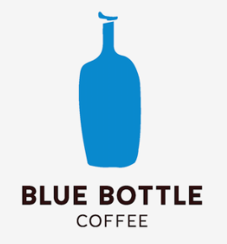
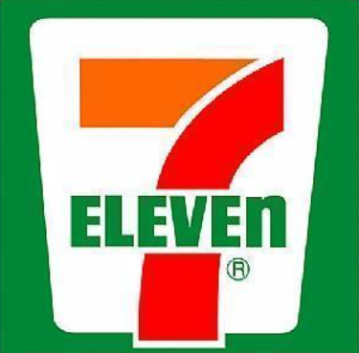
The company cooperates with internationally renowned brands year-round, such as
Bodum DeLonghi
Starbucks Lipton Blue bottle
Disney
We also supply some large supermarkets,
such as the United States costco
Japan 7-11 Germany lidl

Slide 7
Sales results
02
2023 Sales Data Analysis

Slide 8
The instability of the international trade environment in 2023 will have a huge impact on us foreign trade enterprises.
The fluctuation of exchange rates and the intensification of global market competition are putting greater pressure on us.

Slide 9
However
We have withstood the impact of the market

Slide 10
Problems and Challenges
03
The difficulties and setbacks our company encountered in 2023

Slide 11
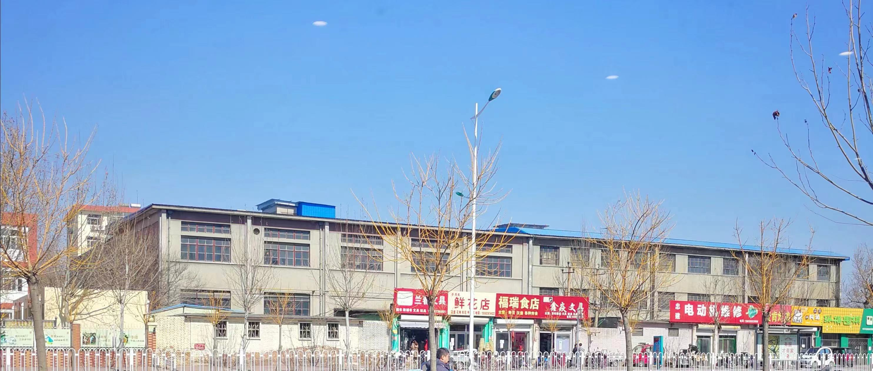
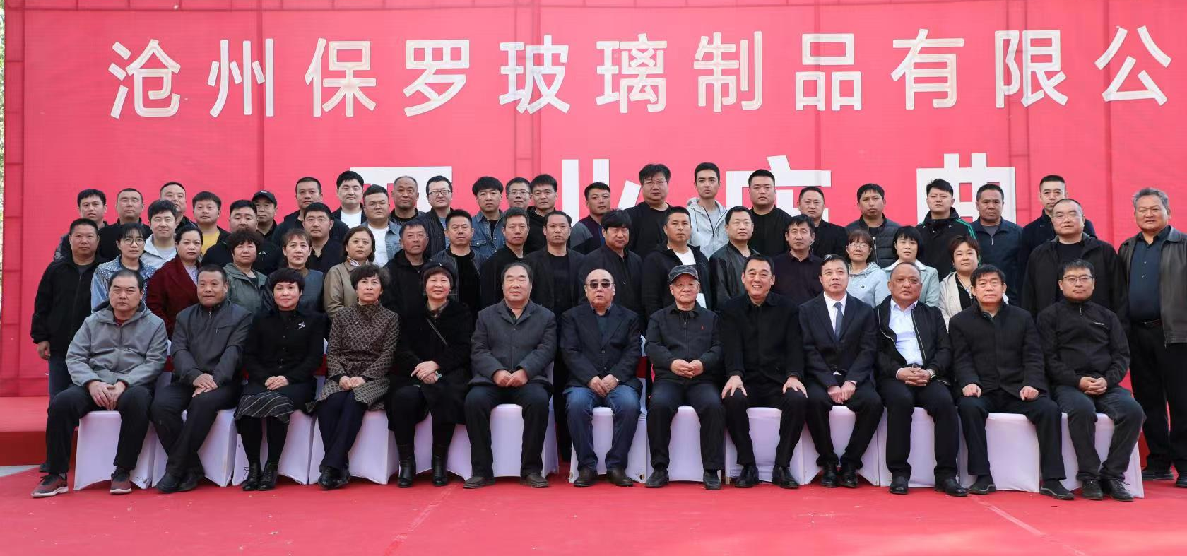
At the beginning of 2023,
Our company is facing the challenge of company relocation
01
02
However, thanks to government support,
We have successfully overcome this difficult period.

Slide 12
For our foreign trade enterprises in 2023
An even more difficult year
After three years of silence, the Canton Fair reopened, but the cumulative export transaction volume decreased by about 15% compared to 2019. The situation in various countries around the world has a huge impact on our foreign trade enterprises.
01
02
However, difficulties are always accompanied by opportunities. With the gradual development of the "the Belt and Road" initiative, we have reason to believe that 2024 will be a year full of hope and opportunities.

Slide 13
Future challenges
04
Outlook for 2024

Slide 14
Looking back on 2023 and looking forward to 2024
Glass cups play an indispensable role in people's daily lives, and our physical foreign trade industry plays an important role in the national economy. Therefore, we are optimistic about the future, and after adjustments and planning in 2023, we plan to achieve a 15% increase in sales revenue by 2024.

Slide 15
Thanks For Watching.

